Slide 1
Introduction to Citrination
Aiden Tepper
MSE 299, 2 Credits
02-09-2021

Slide 2
Hours Summary
Date | Hours | Description of Work
2/08/21 | 2 | Worked through steps 1-3
2/09/21 | 3 | Worked through steps 4-7, created slide deck

Slide 3
Progress
The task assigned this week was to work through the Introduction to Citrination document
There were 7 detailed steps that walked us through creating and analyzing ML models for several distinct sets of data relating to fatigue strength of aluminum compounds
The best way to represent results from this week’s tasks is through the model reports and design reports downloaded from the Citrination website

Slide 4
Problems
The only problems I really encountered through this project had to do with navigation of the Citrination website, which could get somewhat complex at times
A solution to this would be to spend more time exploring the website and its features, as well as getting better oriented with the layout
I also encountered a slight issue when editing the data and retraining, as I deleted the wrong data points and in doing so threw off my machine learning model report
The way I solved this was by redoing the step I made an error on with more caution and attention to detail

Slide 5
Questions
Nothing about the procedure was specifically confusing to me
However, I wasn’t completely clear on what the data represented and what we were trying to figure out through creating the machine learning models
I also know very little on how the ML models work and I’d love to learn more about that

Slide 6
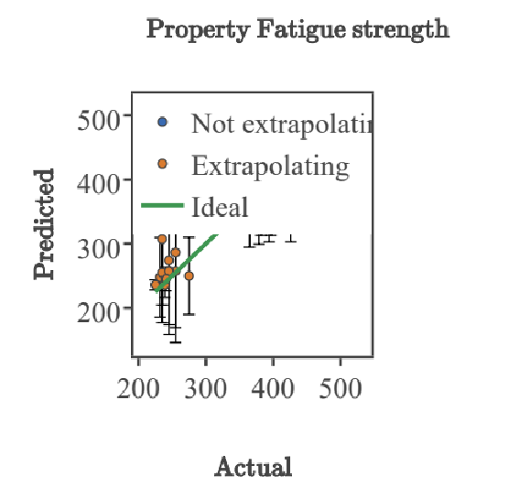
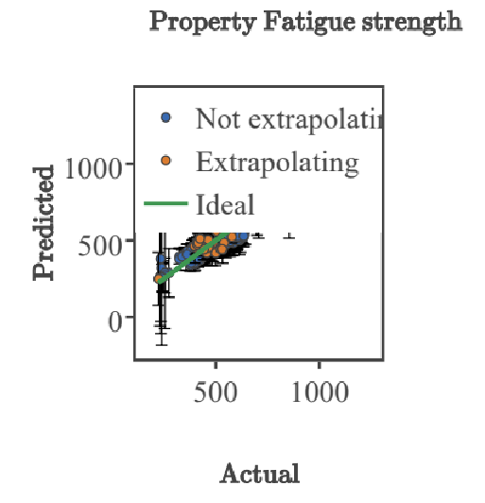
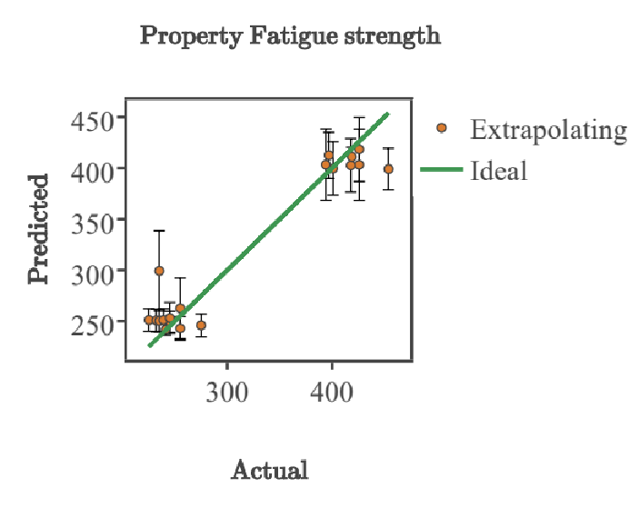
Assessment Figures

